Slide 1
Seba Deleersnyder
DevOps Assurance With OWASP SAMMv2

Slide 2

What is SAMM?
"The prime maturity model for software assurance that provides an effective and measurable way for all types of organizations to analyze and improve their software security posture.”

Slide 3



Why a maturity model?
Measurable
Actionable
Versatile
An organization’s behavior changes slowly over time
Changes must be iterative while working toward long-term goals
There is no single recipe that works for all organizations
A solution must enable risk-based choices tailored to the organization
Guidance related to security activities must be prescriptive
A solution must provide enough details for non-security-people
Overall, must be simple, well-defined, and measurable
OWASP Software Assurance Maturity Model (SAMM)

Slide 4
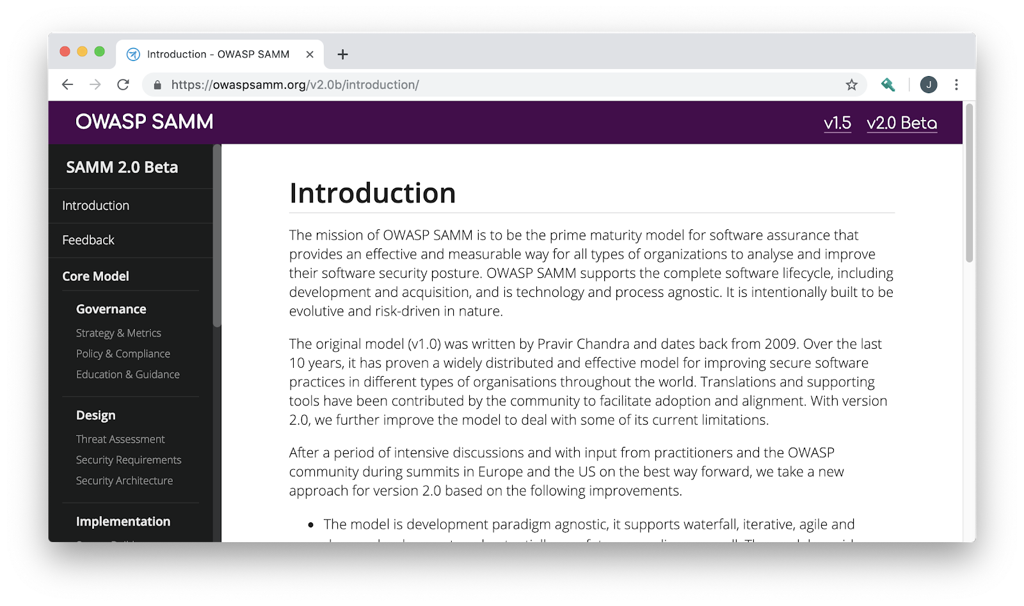
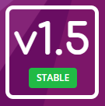
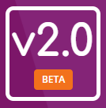
OWASP SAMM
https://owaspsamm.org/

Slide 5
SAMM2 security practices
Governance
Strategy & Metrics
Policy & Compliance
Design
Threat Assessment
Security Requirements
Implementation
Secure Build
Education & Guidance
Security Architecture
Secure Deployment
Defect Management
Verification
Architecture Assessment
Requirements Testing
Security Testing
Operations
Incident Management
Environment Management
Operational Management

Slide 6
Requirements Testing
Streams
 | A: Control Verification | B: Misuse /Abuse Testing
Level 1 - Opportunistically find basic vulnerabilities and other security issues. | Test for standard security controls | Perform security fuzzing testing
Level 2 - Perform implementation review to discover application-specific risks against the security requirements. | Derive test cases from known security requirements | Create and test abuse cases and business logic flaw test
Level 3 - Maintain the application security level after bug fixes, changes or during maintenance | Perform regression testing (with security unit tests) | Denial of service and security stress testing
Maturity
Activities
Notes:
fixme security practice

Slide 7
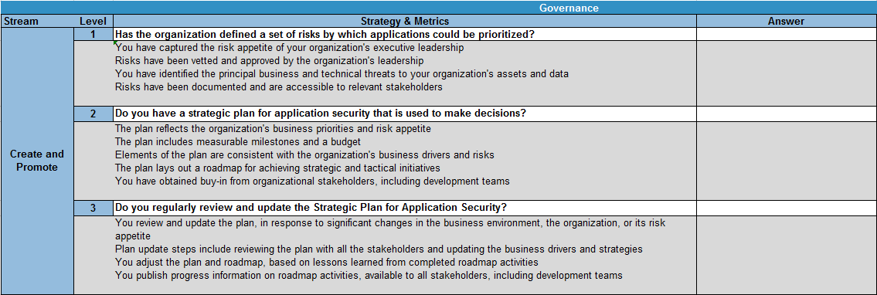
SAMM2 assessments
SAMM2 Toolbox:
https://github.com/OWASP/samm/tree/master/Supporting%20Resources/v2.0/toolbox

Slide 8
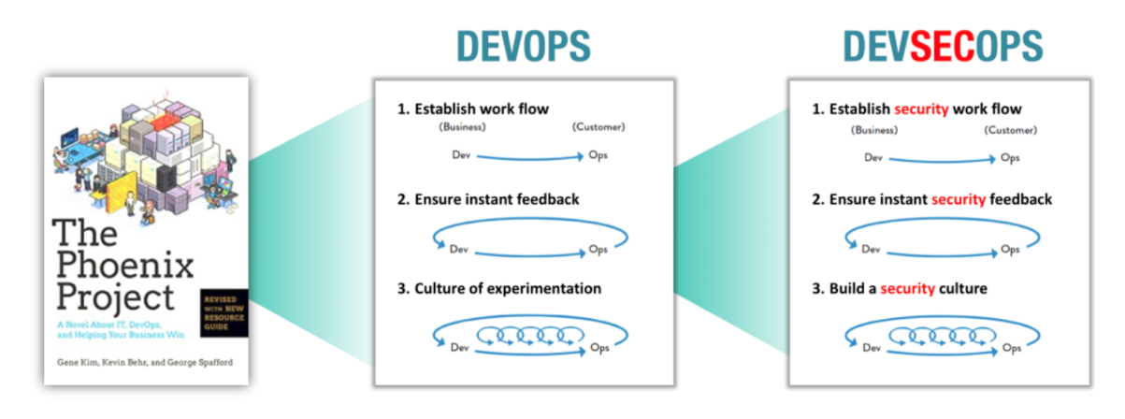
Notes:
https://www.owasp.org/index.php/OWASP_DevSecOps_Maturity_Model

Slide 9
DevSecOps people (elaborate)
awareness training
security champions
security culture
Notes:
people

Slide 10
DevSecOps process
secure deployment
security testing
threat assessment
secure build
operational management
requirements testing
environment management
defect management
Notes:
people

Slide 11
DevSecOps technology
DZone – Introduction to DevSecOps – Jeff Williams
Notes:
Create instant security feedback
A DevSecOps pipeline is the set of tools and processes that
continuously performs security work as code is written,
integrated, tested, deployed, and operated.
A DevSecOps pipeline is the set of tools and processes that
continuously performs security work as code is written,
integrated, tested, deployed, and operated. While there's really
just one delivery pipeline, having a security "view" of your
pipeline may help you understand the security value stream
separately, revealing bottlenecks and inspiring confidence in the
results. The DevSecOps pipeline spans the full lifecycle, handling
both development (vulnerabilities) and operations (attacks).

Slide 12
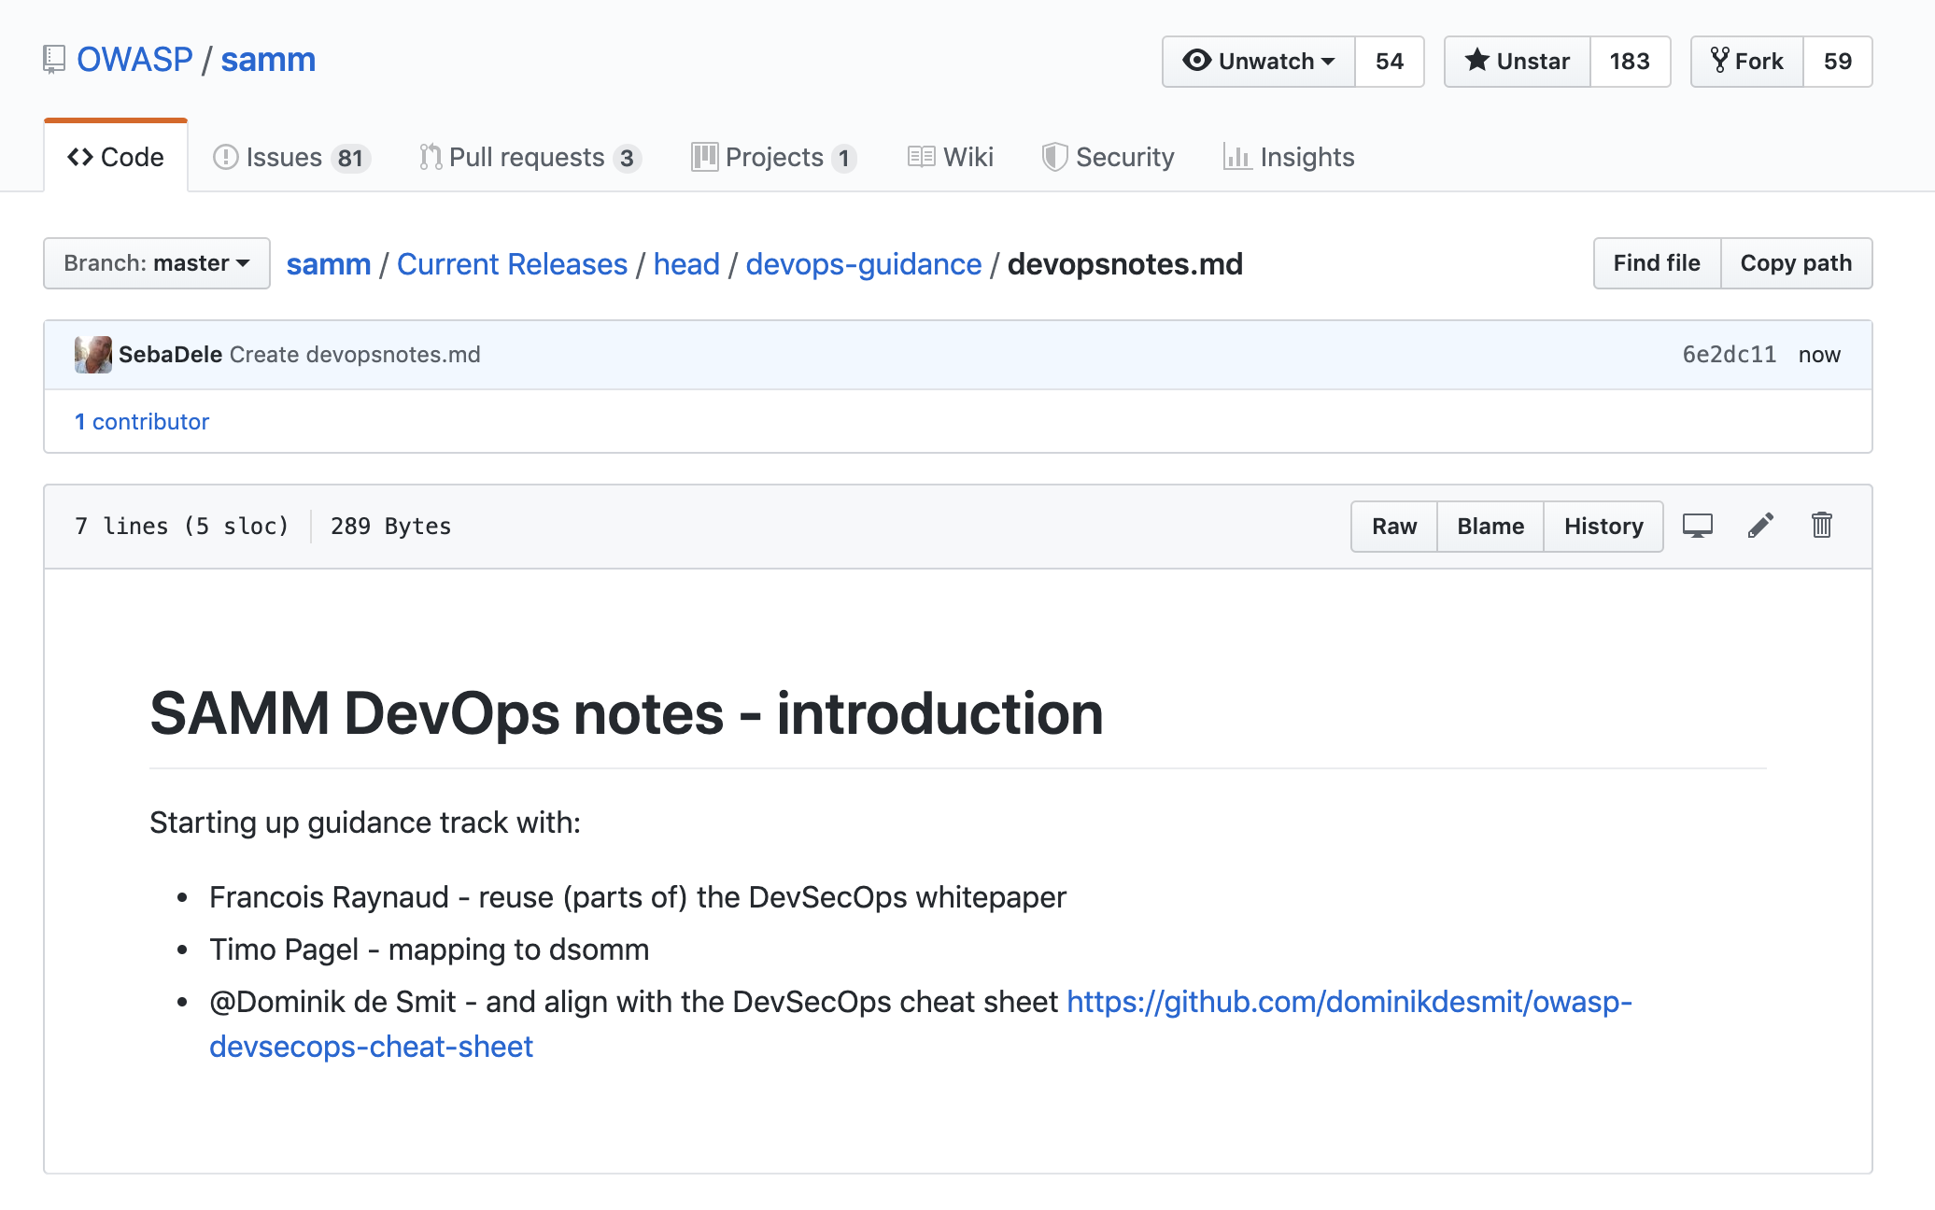
SAMM DevOps guidance
placeholder

Slide 13
SAMM2 and beyond
faster iterative improvements
community driven
OWASP references
process & technology guidance
online tooling
benchmark

Slide 14
Questions? Feedback? Input?
#project-samm
github.com/OWASP/samm

Slide 15
SAMM newsletter
eepurl.com/gl9fb9

Slide 16
Credits
Bart De Win – Project Co-Leader, Belgium
Sebastien (Seba) Deleersnyder – Project Co-Leader, Belgium
Brian Glass – United States
Daniel Kefer – Germany
Yan Kravchenko – United States
Chris Cooper – United Kingdom
John DiLeo – New Zealand
Nessim Kisserli – Belgium
Patricia Duarte - Uruguay
John Kennedy - Sweden
Hardik Parekh - United States
John Ellingsworth - United States
Sebastian Arriada - Argentina
Brett Crawley – United Kingdom
...

Slide 17

Seba Deleersnyder
CEO Toreon
Belgian OWASP chapter founder
SAMM project co-leader
seba@owasp.org @sebadele

Slide 18
